Slide 1
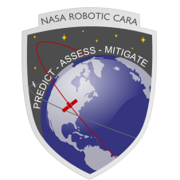

Conjunction Assessment Risk Analysis
EventRate
A Program to Estimate Expected Serious Conjunction Rates for CARA Missions
Doyle Hall and Nicholas Ravago (Omitron)
2022 April 11
Last Updated 2026 January 5

Slide 2
Program EventRate: Outline
Introduction, summary, objectives and methodology
Description of program inputs and outputs
Usage instructions
Analysis examples
Installation and troubleshooting contact information

Slide 3
Program EventRate: Introduction and Summary
The Matlab program EventRate estimates the rates that prospective CARA missions can expect to experience serious conjunctions, which are events that have last-update collision probability (Pc) values exceeding the specified threshold for risk mitigation maneuvers (RMMs)
The program can also estimate cumulative Pc values* over the on-orbit lifetimes of prospective missions
EventRate uses a semi-empirical simulation estimation algorithm, basing estimates on the extensive database of conjunction state and covariance data archived for previous and current CARA missions
It allows trade-space analyses of several satellite and mission parameters:
Satellite HBR On-orbit lifetime Catastrophic events
RMM Pc threshold RMM commit times RMM type (trans. vs rot.)
Catalog growth factor CARA orbital regime
It also produces several graphical outputs illustrating the archived conjunction data used in the analysis, as well as the estimated event rates, cumulative Pc values, and associated estimation uncertainties
*Perceived cumulative probabilities as measured by last-update Pc values

Slide 4
Program EventRate: Objectives
Primary objective: Provide estimates of the occurrence rates of serious conjunction events expected for current or prospective CARA missions
Serious events occur when the most recent available conjunction Pc estimate (i.e., the last-update Pc value) exceeds a risk-tolerance threshold
The risk-tolerance threshold is the Pc cutoff that a mission uses when deciding to perform or not perform a risk mitigation maneuver (RMM) ⎯ e.g., RMM Pc = 4.4e-4
The last-update Pc for a conjunction is the latest Pc estimate available before a mission’s RMM “commit” time limit is reached, but that is also estimated after the mission’s RMM “consider” time limit ⎯ e.g., commit at 1 day before TCA and consider at 3.5 days
Secondary objective: Provide associated estimates of perceived mission-cumulative Pc values, both with and without RMMs being performed
The perceived mission-cumulative Pc represents an empirical estimate of the combined risk of all conjunctions experienced by a satellite throughout its active, on-orbit lifetime
For last-updates below the Pc threshold, no RMM is performed in the simulation, and the last-update Pc value itself provides a measure of the perceived risk of the event
For last-updates above the Pc threshold, however, an RMM is performed, and the estimated post-RMM Pc value provides a measure of the perceived risk of the event
The mission-cumulative Pc combines the perceived risks for all of the conjunctions experienced during an entire mission into one composite collision probability

Slide 5
Program EventRate: Methodology
Perform a semi-empirical serious event rate and cumulative risk analysis
For details of the formulation see Hall (2019) “Determining Appropriate Risk Remediation Thresholds From Empirical Conjunction Data Using Survival Probability Methods” AAS-631
Uses input OCMDB or OCMDB_PcTable.mat files for archived data (extracted from CARA database)
PcTable files for the examples outlined in this presentation are provided in the data/directory
For further analyses, a PcTable file containing conjunction information approved for release to the general public is provided in the data/ directory. Refer to the curated satellite list in the doc/ directory to select satellite IDs suitable for a given mission analysis.
Allow users to specify multiple parameters for prospective CARA missions
Satellite parameters: Hard-body radius (HBR) and on-orbit mass
Mission parameters: Active on-orbit lifetime, orbital regime, flag to include vs exclude likely non-catastrophic collisions, and a secondary catalog population growth factor
Risk mitigation maneuver parameters: RMM Pc threshold, RMM commit and consider times, RMM type (translational vs rotational), and the RMM Pc reduction factor
Perform the following multi-step analysis using archived conjunction data:
Calculate conjunction Pc values based on the prospective mission’s HBR value
Determine last-update Pc values based on the mission’s RMM commit/consider times
Use a sample with replacement methodology to simulate multiple realizations of the sequence of last-update Pc values experienced by the mission ⎯ see Hall (2019)
Estimate the expected rate that last-update Pc values exceed the RMM Pc threshold
Estimate the perceived mission-cumulative Pc value both with and without RMMs
Estimate 95% uncertainties based on the variations between multiple mission realizations

Slide 6
Program EventRate
Description of Program Inputs and Outputs

Slide 7
Program EventRate: Example Input Parameter Specification File (for ‘LEO22_HST_Example1’)
%% Function EventRate parameter specification file
% for a prospective mission in an HST-like orbit
%% Emprical orbital conjunction data set parameters
% OCMDB file holding archived conjunction data
params.PcTableFile = 'data\Test_C.mat';
% Set of CARA primaries to combine for the semi-empirical analysis
params.priset = 20580; % Only include HST itself for this example
% CARA orbital regime (optional) which contains the primaries
params.priorb = 'LEO2-2';
%% Mission parameters for the prospective satellite mission
% Basic mission parameters
params.mission_name = 'NewHST';
params.mission_HBR_meters = 10;
params.mission_duration_years = 15;
params.mission_on_orbit_mass_kg = 10800;
% Pc threshold for execution of risk mitigation maneuvers (RMMs)
params.EventRate_Pc_value = 1.0e-4;
% Mission RMM commit and consider times (days before TCA)
params.Tcommit_days = 1.0;
params.Tconsider_days = params.Tcommit_days+2.5;
% Include or exclude likely non-catastrophic events for RMMs
params.exclude_noncatastrophic = false;
% Type of RMM: Translational (default, most common) or Rotational (less common)
params.RemManeuver = 'Translational';
params.RemReduction = 0.03; % RMM reduction factor = Pc(post-RMM)/Pc(pre-RMM)
% Secondary population growth factor for the mission
% (e.g., a factor of 1.3 indicates that the prospecive mission encounters
% a future secondary satellite population 30% larger than in the archived
% data set; default = 1)
params.SecondaryCatalogGrowth = 1.3;

Slide 8
Program EventRate: Example Text Output and Function Output Variables
Text output from executing EventRate(‘LEO22_HST_Example1’)
--- Summary of Semi-empirical Estimation Analysis ---
Orbit: 20580 (541km x 556km x 28deg in LEO2-2)
Interval: 2009-02-25 17:06 to 2019-01-27 18:31 (9.92 yr)
Commit/consider time limits: 1 to 3.5 day
Likely non-catastrophic events: Included
Unique events: 997 of 1600 within commit time limits
NewHST: duration = 15 years, HBR = 10 m, growth = 1.3
RMM threshold Pc = 1e-4 (RMM type = translational, RMM reduction = 0.03)
Mission average above-threshold event rate = 0.71 / year (95%: 0.27 to 1.33)*
Mission cumulative Pc (with RMMs) = 2.1e-3 (95%: 1.6e-3 to 2.6e-3)*
Mission cumulative Pc (no RMMs) = 8.1e-3 (95%: 3.2e-3 to 1.7e-2)*
*Quantities in red also output as Matlab function variables
Note: Small numerical output differences from those presented in the proceeding slides may arise due to differences in hardware architecture or software

Slide 9
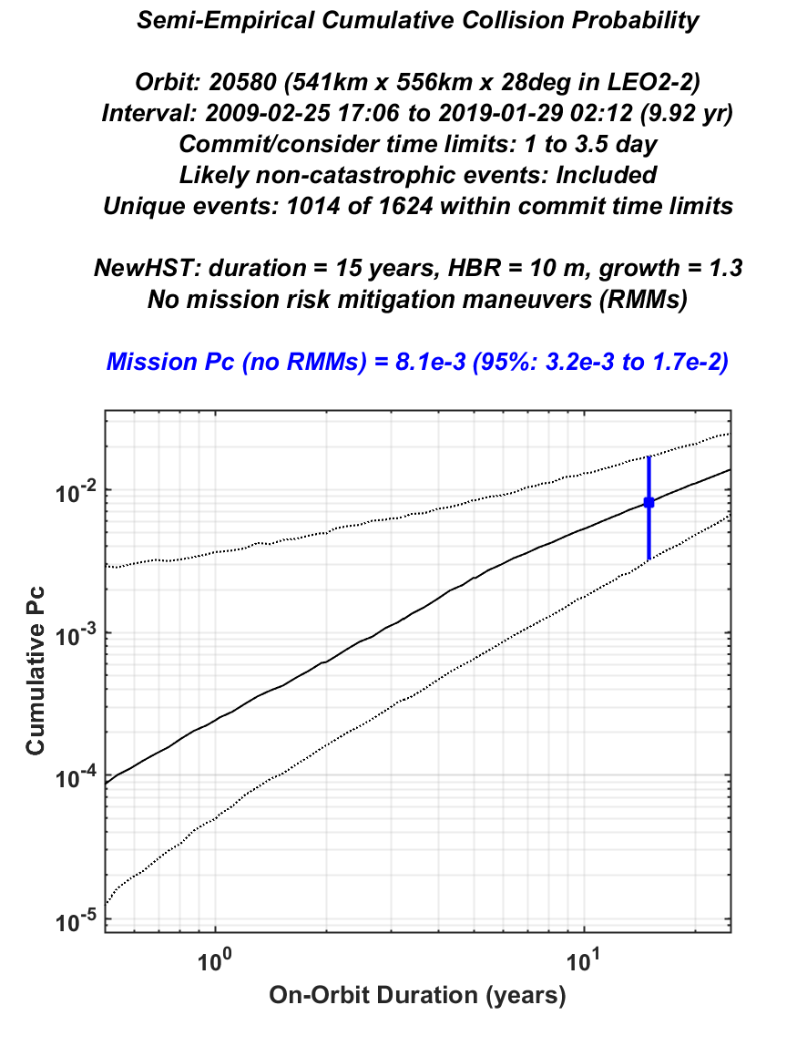
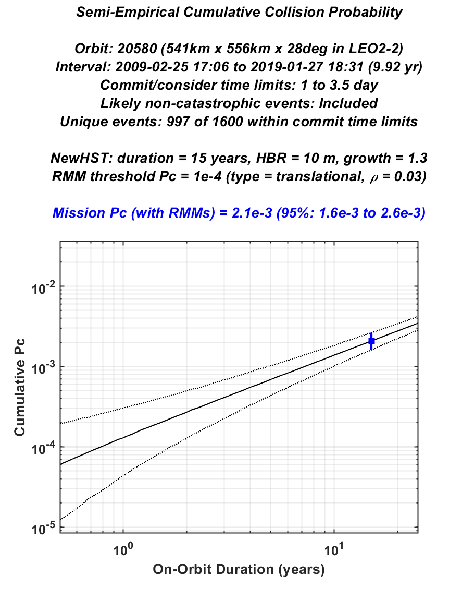
Program EventRate: Plotted Cumulative Pc vs On-Orbit Duration
LEO22_HST_Example1
Mission-cumulative Pc with no RMMs performed
LEO22_HST_Example1
Mission-cumulative Pc with RMMs performed

Slide 10
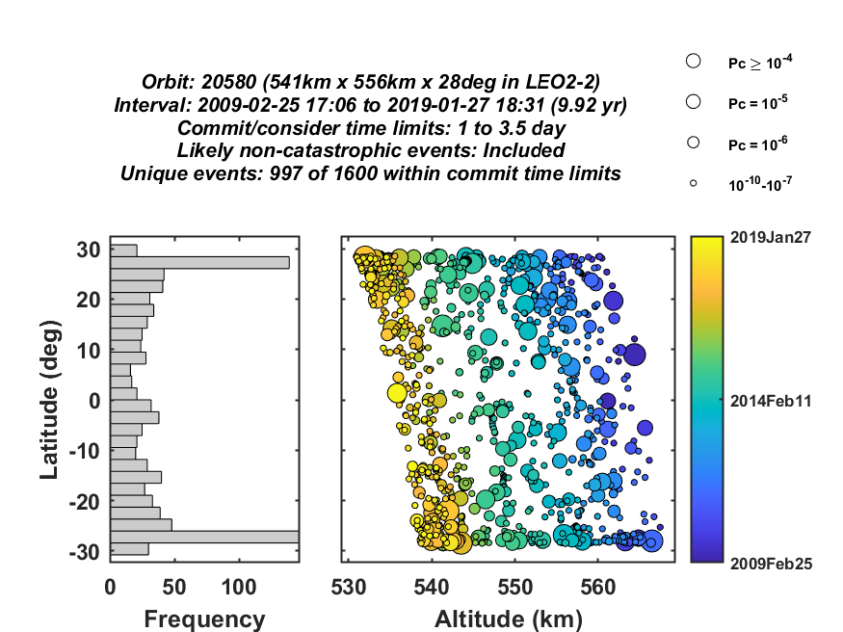
Program EventRate: Plotted Spatial Distribution of the Analyzed Unique Conjunction Events

Slide 11
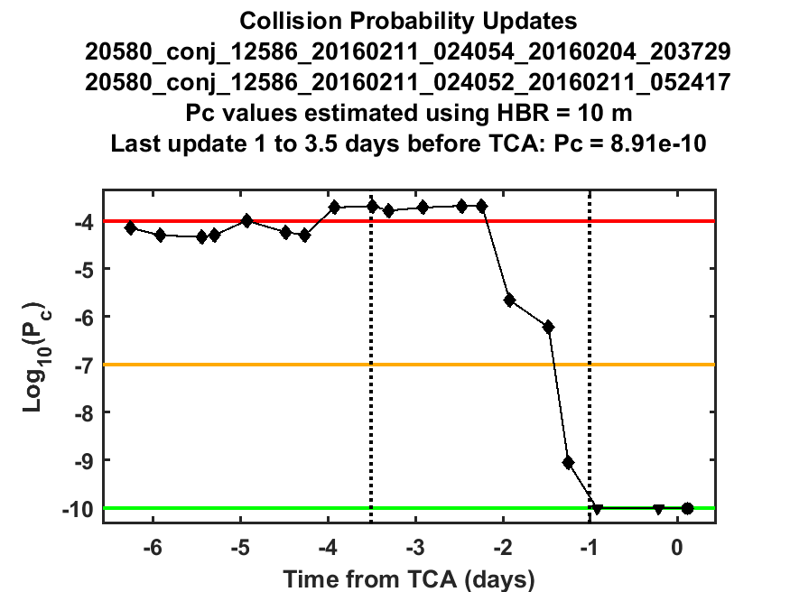
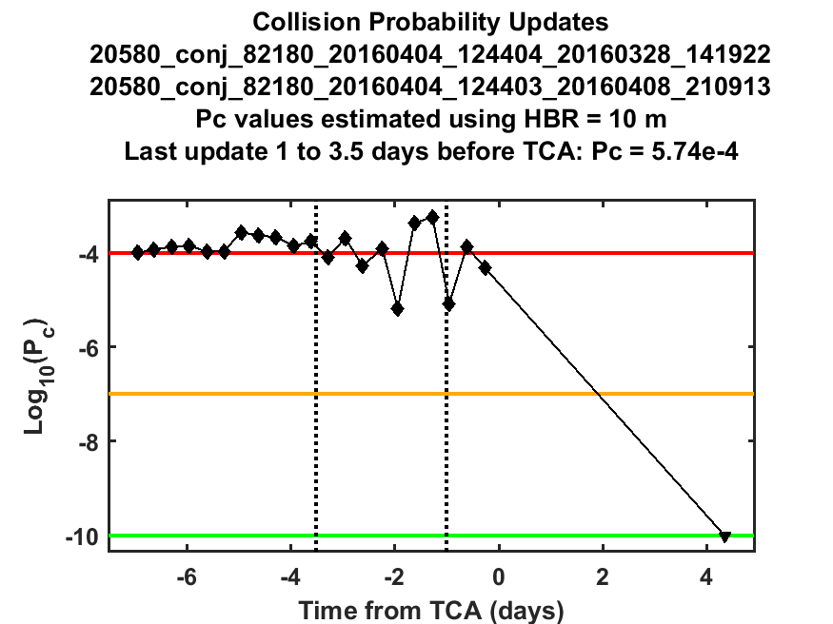
Program EventRate: Plotted Pc Update Sequences for the Analyzed Unique Events

Slide 12
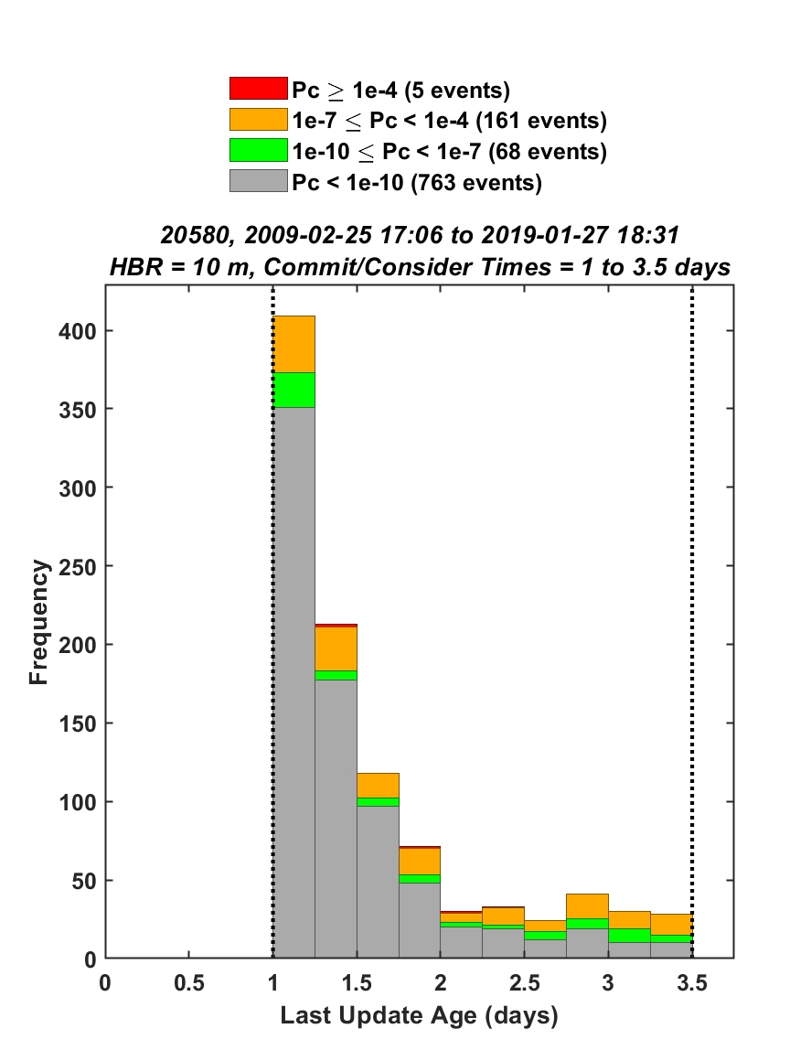
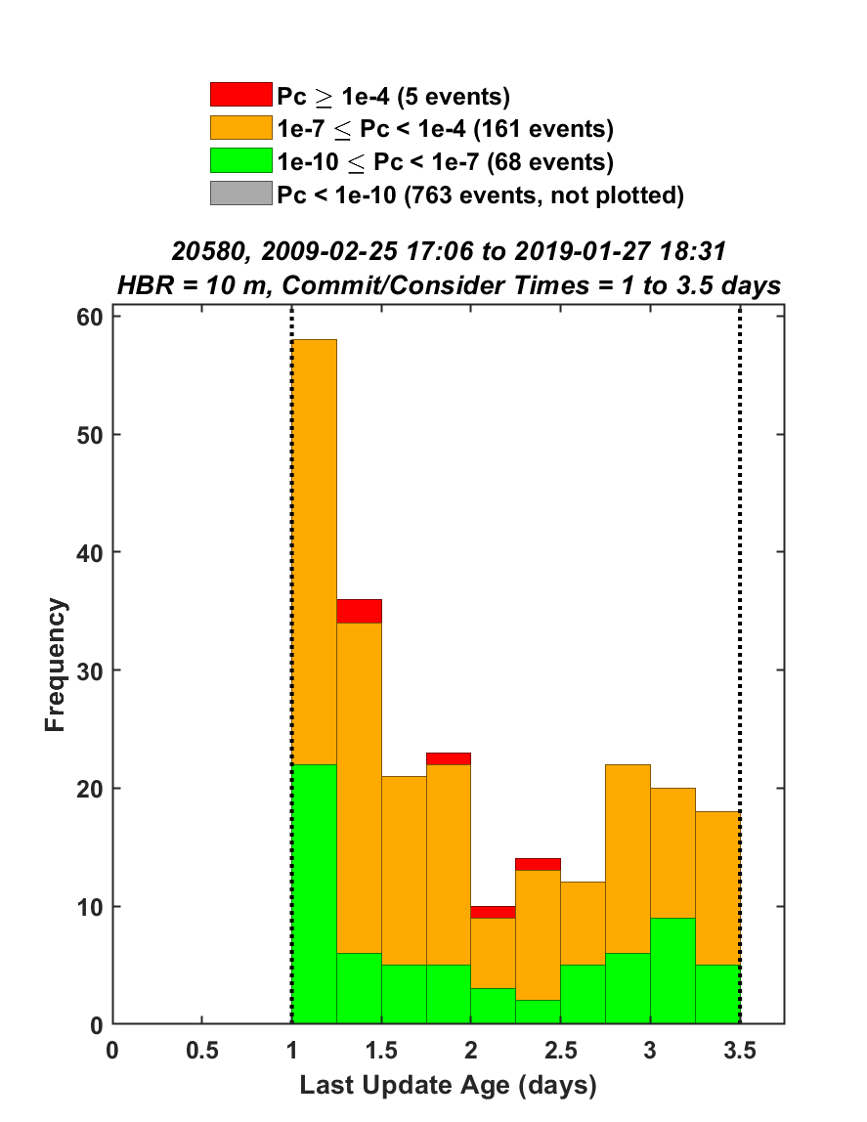
Program EventRate: Plotted Distributions of Last-Update Pc Values for the Unique Events

Slide 13
Program EventRate
Usage Instructions

Slide 14
Usage Instructions for Program EventRate Page 1
Program EventRate obtains required input parameters using a parameter specification file. Several example parameter specification files are provided in the “params” directory of the default distribution (such as LEO22_HST_Example1.m). These files can be used as templates for building new parameter files.
To estimate serious event rates for a prospective (or current) CARA mission, first find the CARA orbital regime that the mission plans to occupy (e.g., LEO2-3, LEO3-3, etc.).
Next, find a set of one or more current or past CARA missions within the CARA orbital regime that have orbital parameters most similar to that of the prospective mission. The archived conjunction data for this “selected” set of satellites will be used within the semi-empirical analysis algorithm.
For example, in the pre-launch phase of a planned LEO2-2 mission with orbital parameters similar to those of the Hubble Spare Telescope (HST) mission, one would select HST itself (20580), as shown in the parameter file the LEO22_HST_Example1.m.
Similarly, for a planned LEO3-2 mission with an orbital parameters similar to those of the A-train satellites, one could combine the archived conjunction data for the following four selected A-train members: 27424 (Aqua), 28376 (Aura), 38337 (GCOM-W1), 40059 (OCO-2), as shown in the parameter file LEO23_Atrain_Example1.m.
All other mission parameters for the prospective mission (i.e., HBR, on-orbit lifetime, etc.) do not have to be similar to those of the selected CARA missions. So for the A-train example above, the prospective mission does not need to have an HBR that is the same as (or event similar to) any of the selected A-train satellites. The semi-empirical analysis algorithm only uses archived conjunction states and covariances, which do not depend on archived HBR values or other mission properties.

Slide 15
Usage Instructions for Program EventRate Page 2
Build an OCMDB database .mat file that holds all of the conjunction data for the selected satellites, or a corresponding OCMDB PcTable file that holds precalculated Pc values.
For LEO22_HST_Example1, the Test_C.mat file is provided in the distribution.
For LEO23_Atrain_Example1, the Test_B.mat file is provided in the distribution
An OCMDB PcTable file containing a curated set of missions is provided in the data directory and a list of curated satellites in this file is provided in the doc directory. Users desiring data from other missions or timeframes may reach out to the CARA team via an issue request on the GitHub site.
Copy one of the provided example parameter specification files to a file to be used for the prospective mission being analyzed. For example, for a new mission in an HST-like orbit, the file LEO22_HST_Example1.m could be copied to a file called New_Mission.m. This new file should be placed within the “params” subdirectory.
Edit the new parameters specification file to reflect the desired properties for the prospective mission, which should include the following satellite and mission properties:
Short name of prospective mission: mission_name (recommended length: five characters or less)
Satellite properties: mission_HBR_meters, mission_duration_years, and mission_on_orbit_mass_kg
RMM execution threshold Pc value: EventRate_Pc_value
RMM commit/consider times (days before TCA): Tcommit_days and Tconsider_days
Type of RMM maneuver RemManeuver and associated Pc reduction factor RemReduction
Flag to exclude likely non-catastrophic events for RMMs: exclude_noncatastrophic
Secondary population growth factor for the mission: SecondaryCatalogGrowth

Slide 16
Usage Instructions for Program EventRate Page 3
Execute the EventRate function from the main EventRate directory for the analysis, using the following calling syntax:
EventRateOutput = EventRate(‘New_Mission’);
Upon completion EventRateOutput will hold the quantitative estimates from the semi-empirical analysis, with the following fields
MissionEventRate = 1x3 array holding the estimated mission-average RMM rate, and the associated 95% variation range for the multi-realization semi-empirical analysis: [median, 95%-low, 95%-high].
CumulativePcNoRMMs = 1x3 array holding the estimated mission-cumulative Pc value for the mission if no RMMs were executed at all to mitigate the collision risk, and the associated 95% variation range for the multi-realization semi-empirical analysis: [median, 95%-low, 95%-high].
CumulativePcWithRMMs = 1x3 array holding the estimated mission-cumulative Pc value for the mission if all threshold-level RMMs were executed to mitigate the collision risk, and the associated 95% variation range for the multi-realization semi-empirical analysis: [median, 95%-low, 95%-high].
Details of the core ConjDist function analysis, only required for debugging and advanced analysis
Also upon completion, EventRate will create a new subdirectory in the “output” directory populated with the output plot files and a text log file with the details of the analysis.
If performing a trade-study of pre-launch prospective mission parameters, adjust one or more of the parameters in step 6, and rerun EventRate in order to see the quantitative effects of the adjustment(s) on the output numerical estimates MissionEventRate, CumulativePcNoRMMs and CumulativePcWithRMMs, as well as the corresponding changes in the associated analysis plots.

Slide 17
Program EventRate
Analysis Examples
(all provided with the default EventRate distribution)
Note: Small numerical output differences from those presented in the proceeding slides may arise due to differences in hardware architecture or software

Slide 18
Program EventRate: Serious Event Rate and Cumulative Risk Analysis Examples
A new mission in LEO2-2 with an orbit like that of the HST satellite
Translational vs rotational risk mitigation maneuvers
A new mission in LEO3-2 with an orbit like that of the NOAA 18 & 19 satellites
Changing the risk mitigation maneuver threshold Pc level
Changing the mission Hard Body Radius (HBR)
A new mission in LEO3-3 with an orbit like that of the METOP A & B satellites
Short-duration vs long-duration active on-orbit mission lifetime
A new mission in LEO1-1 with an orbit like that of the GPM satellite
Very low collision risk mission scenario
A new mission in LEO2-3 with an orbit like that of the A-train satellites
Changing the RMM commit and consider times
A new mission in LEO3-2 with an orbit like that of the DMSP satellites
Changing the secondary catalog growth factor
A new mission in HEO with an orbit like that of the Van Allen satellites
A very large (HBR = 50 m) satellite in a high eccentricity orbit
Note: Orbit regime definitions may be found in the file “EventRate Orbit Regime Definitions.xlsx” in the doc directory
*Note: Non-catastrophic analysis is only available using complete OCMDB files. The default distribution only contains OCMDB PcTable files, which do not have enough information for this analysis mode.

Slide 19
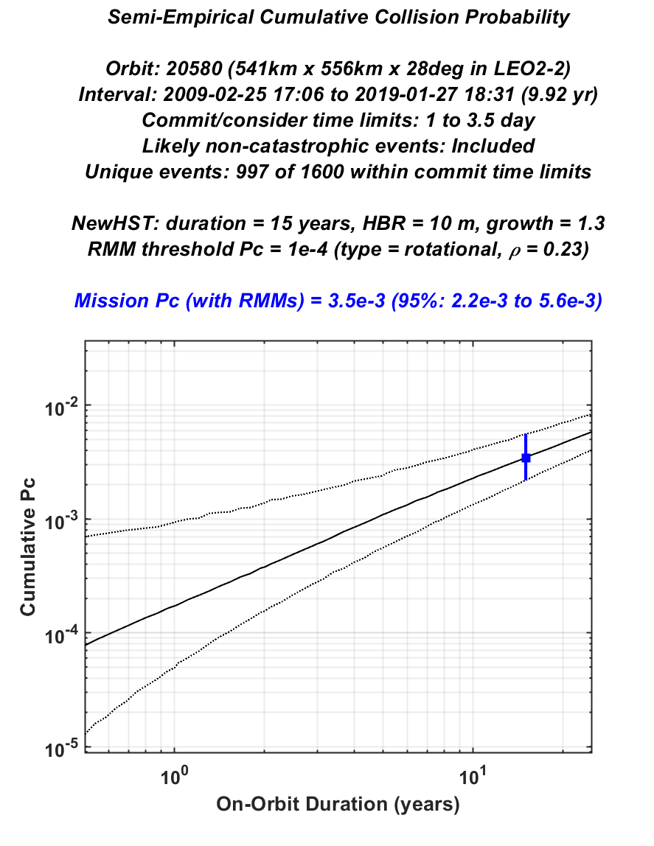
EventRate Cumulative Pc vs Duration Translational vs Rotational Risk Mitigation Maneuvers
LEO22_HST_Example1
Translational RMMs (ρ = 0.03)
15-year Cumulative Pc* ≈ 2.1e-3
LEO22_HST_Example2
Rotational RMMs (ρ = 0.23)
15-year Cumulative Pc* ≈ 3.5e-3
*Cumulative 15-year mission Pc with no RMMs ≈ 8.1e-3

Slide 20
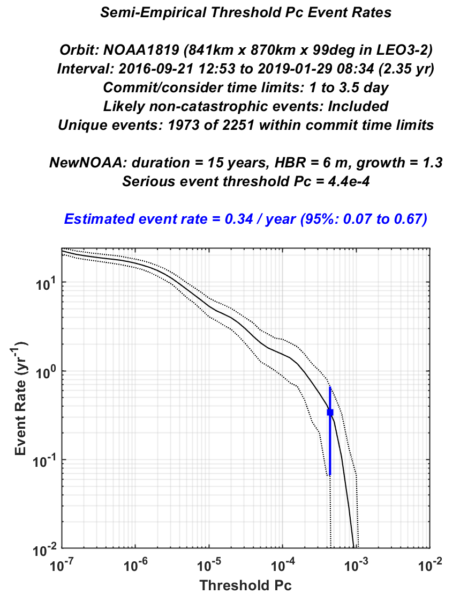
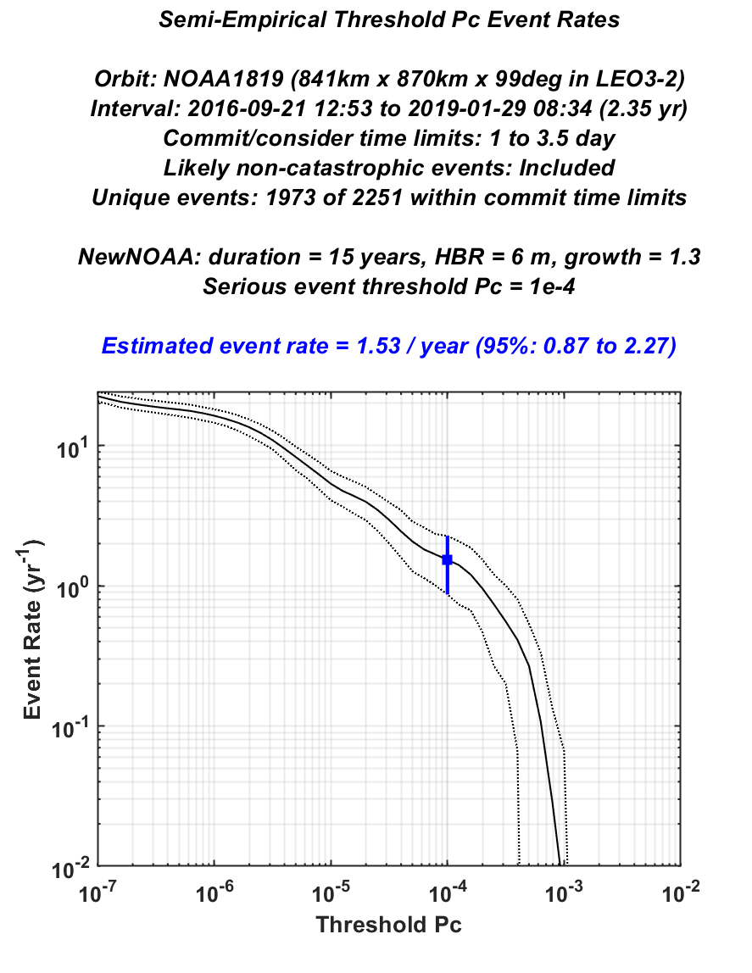
EventRate RMM Rate vs Threshold Pc Changing Risk Mitigation Maneuver Threshold Pc Level
LEO32_NOAA1819_Example1
RMM threshold Pc = 4.4e-4
RMM Rate ≈ 0.34 / year
LEO32_NOAA1819_Example2
RMM threshold Pc = 1.0e-4
RMM Rate ≈ 1.53 / year

Slide 21
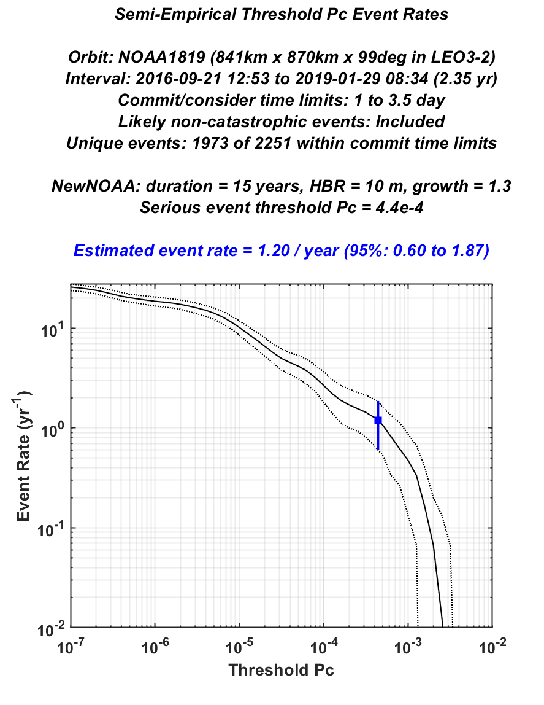
EventRate RMM Rate vs Threshold Pc Changing the Mission Hard Body Radius
LEO32_NOAA1819_Example1
Mission HBR = 6 m
RMM Rate ≈ 0.34 / year
LEO32_NOAA1819_Example3
Mission HBR = 10 m
RMM Rate ≈ 1.2 / year

Slide 22
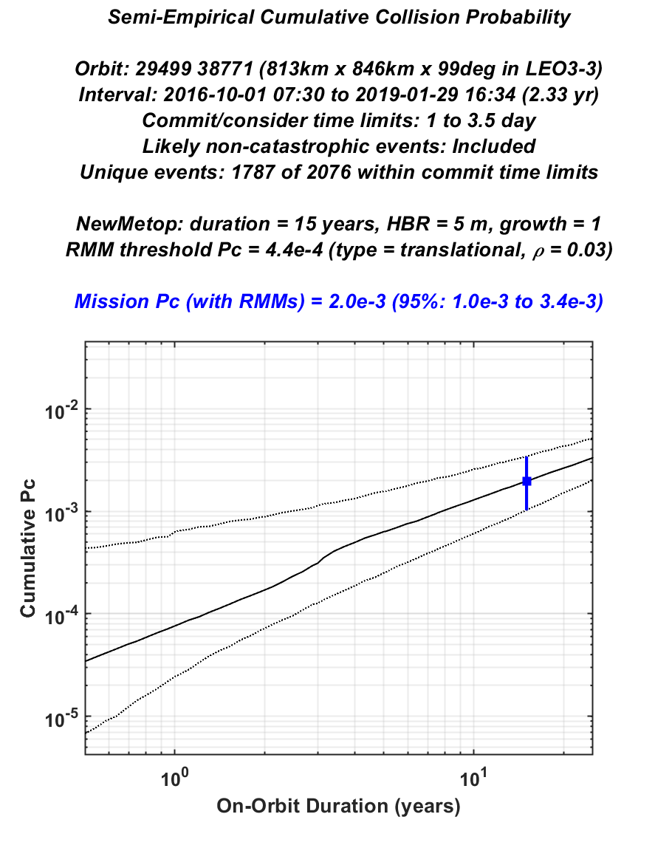
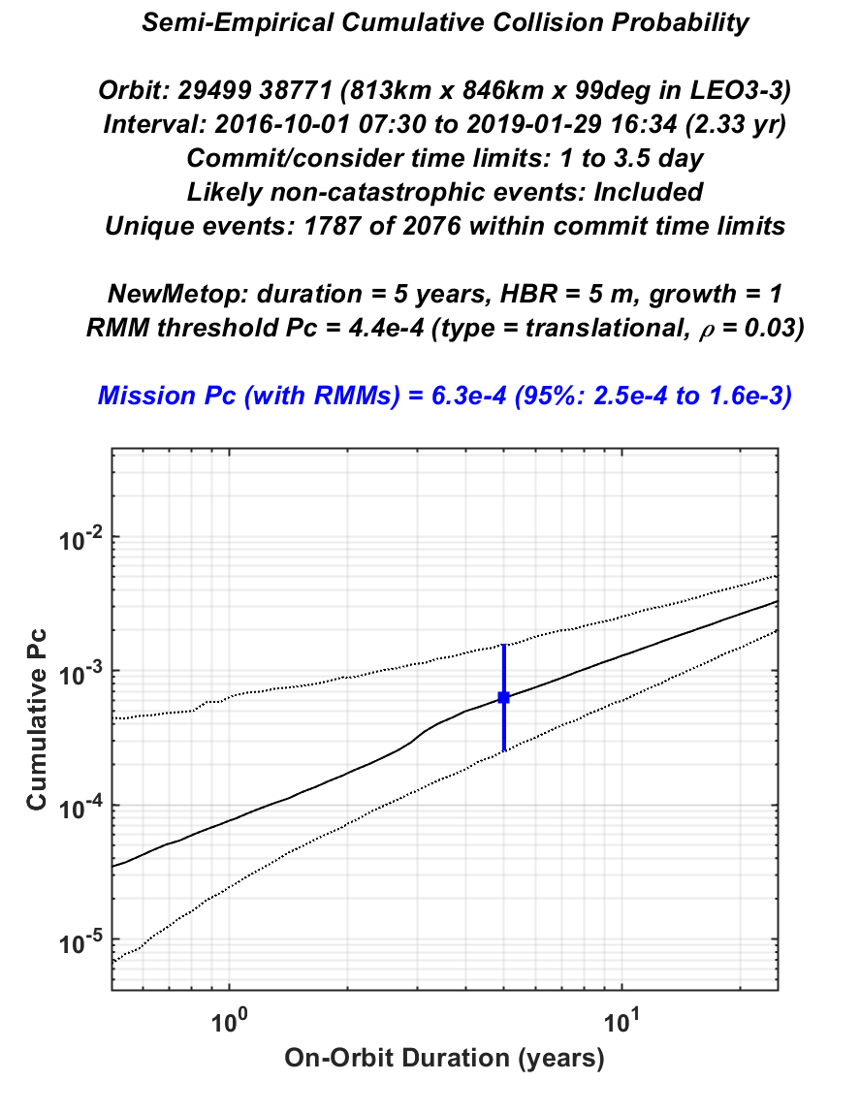
EventRate Cumulative Pc vs Duration Short- vs Long-Duration Active On-orbit Mission Lifetime
LEO33_METOPAB_Example1
Mission Duration = 15 years
Mission Cumulative Pc ≈ 2.0e-3
LEO33_METOPAB_Example2
Mission Duration = 5 years
Mission Cumulative Pc ≈ 6.3e-4

Slide 23
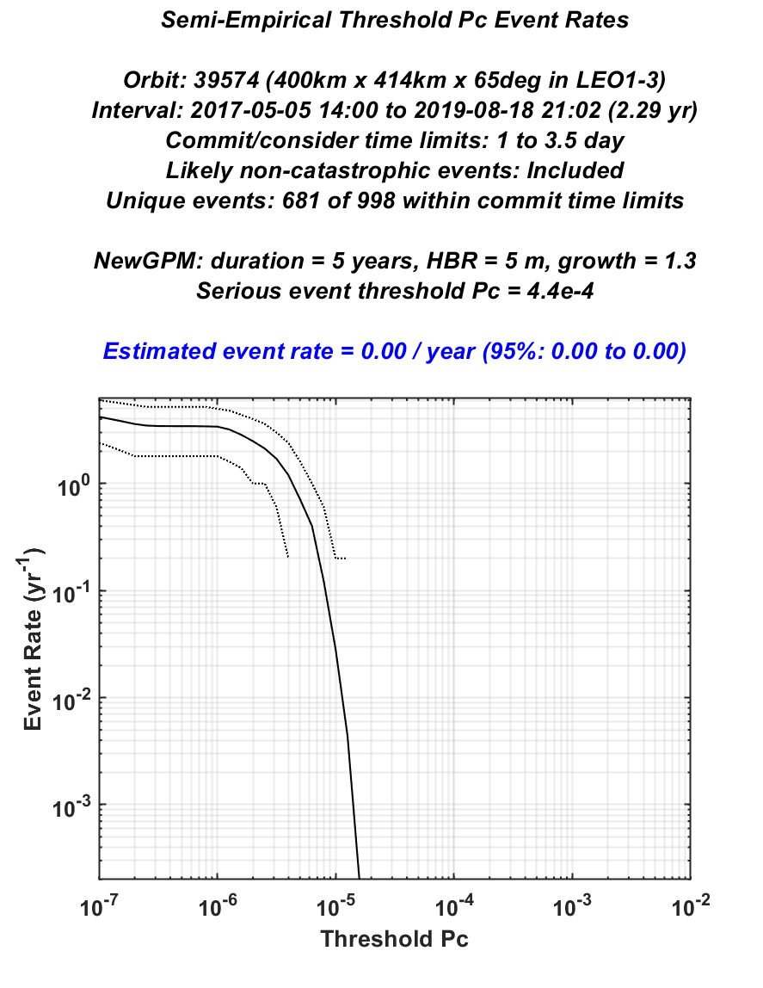
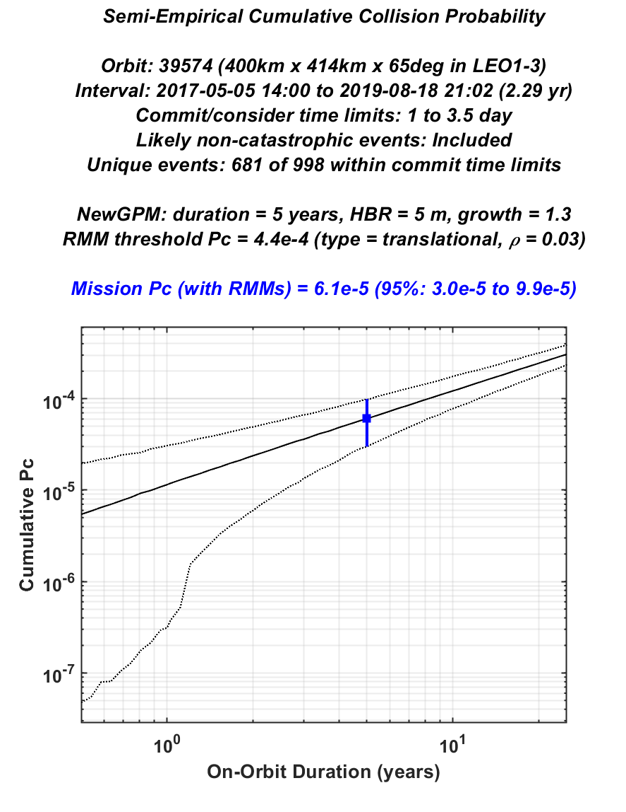
EventRate Event Rate & Cumulative Pc Very Low Collision Risk Mission Scenario
LEO11_GPM_Example
HBR = 5 m and Duration = 5 years
Mission RMM Rate ≈ 0.0 / year
LEO11_GPM_Example
HBR = 5 m and Duration = 5 years
Mission Cumulative Pc ≈ 6.1e-5

Slide 24
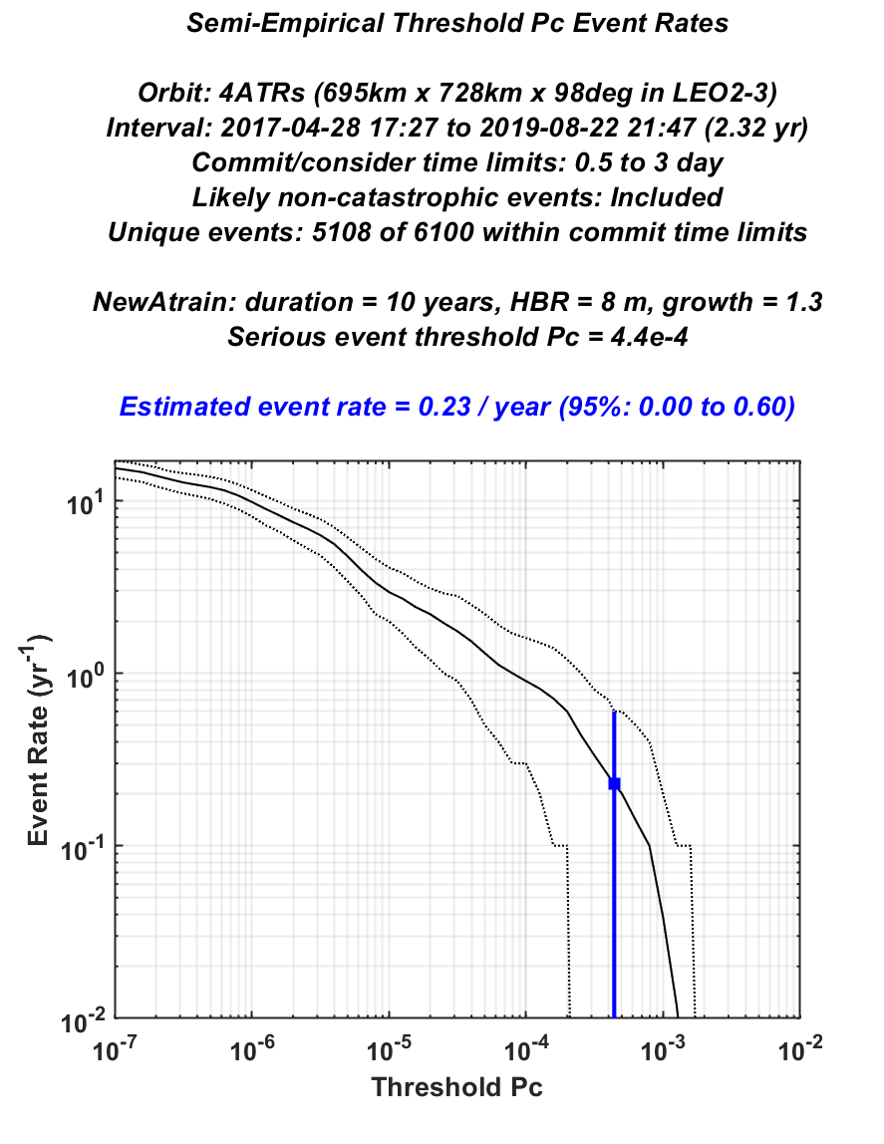
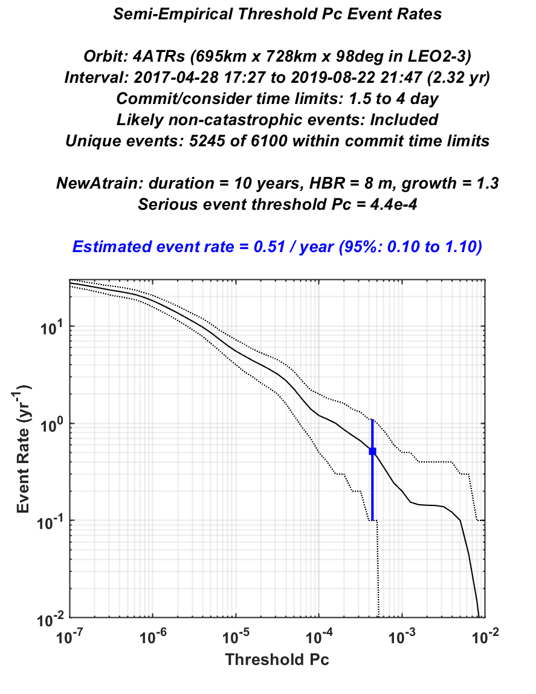
EventRate RMM Rate vs Threshold Pc Changing the RMM Commit and Consider Times
LEO23_Atrain_Example1
Commit-Consider = 0.5-3.0 days
RMM Rate ≈ 0.23 / year
LEO23_Atrain_Example2
Commit-Consider = 1.5-4.0 days
RMM Rate ≈ 0.51 / year

Slide 25
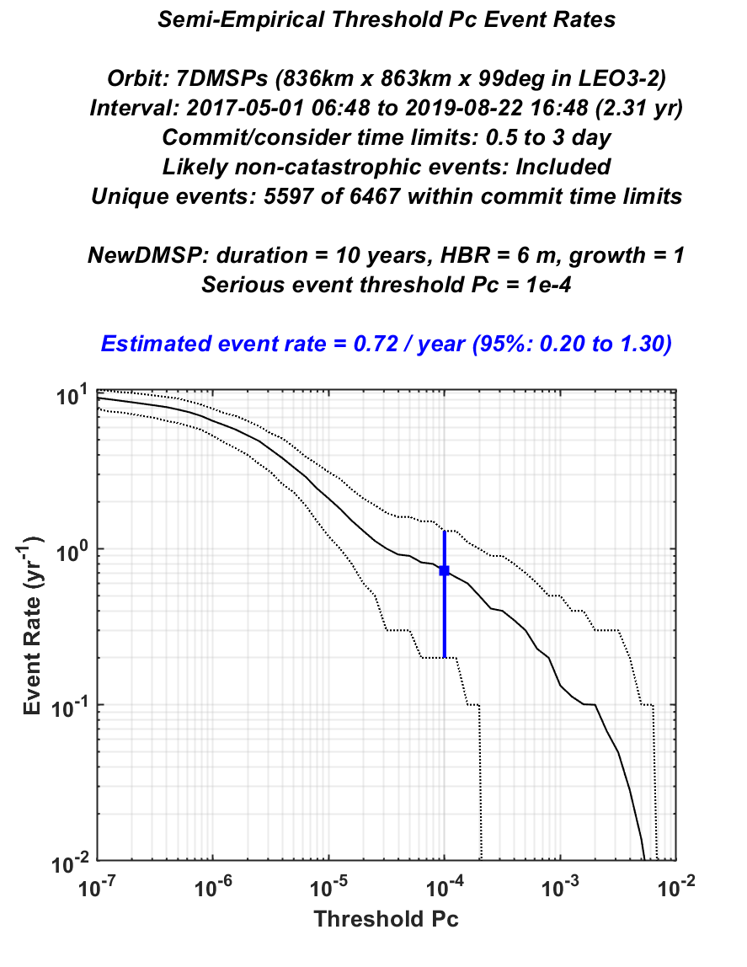

EventRate RMM Rate vs Threshold Pc Changing the Secondary Catalog Growth Factor
LEO32_DMSP_Example1
Secondary Catalog Growth = 1.0
RMM Rate ≈ 0.72 / year
LEO32_DMSP_Example2
Secondary Catalog Growth = 1.5
RMM Rate ≈ 1.10 / year

Slide 26
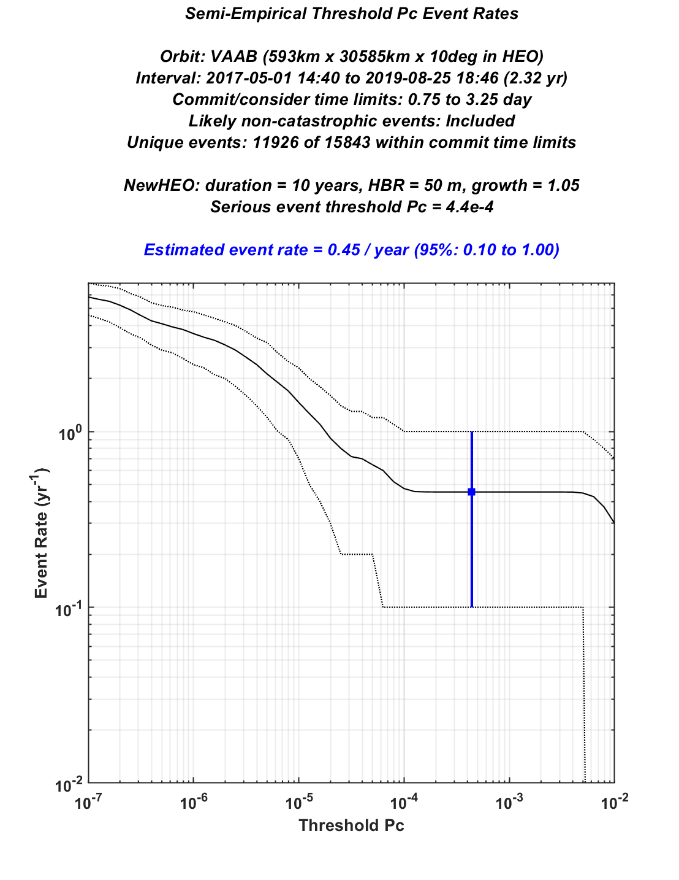
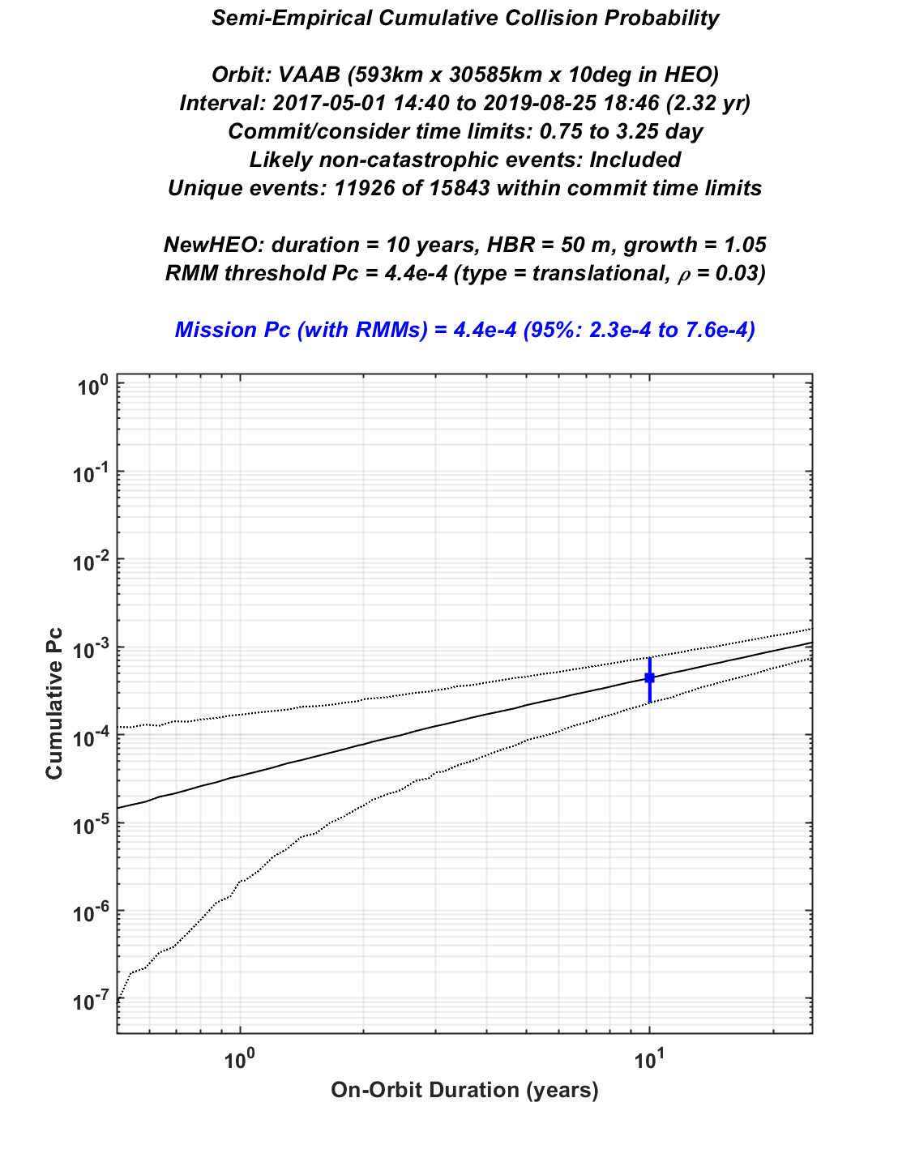
EventRate Event Rate & Cumulative Pc Very Large Satellite in High Eccentricity Orbit
HEO_VanAllen_Example
HBR = 50 m & Duration = 10 years
Mission RMM Rate ≈ 0.45 / year
HEO_VanAllen_Example
HBR = 50 m & Duration = 10 years
Mission Cumulative Pc* ≈ 4.4e-4
*Cumulative mission Pc with no RMMs ≈ 0.15

